Slide 1
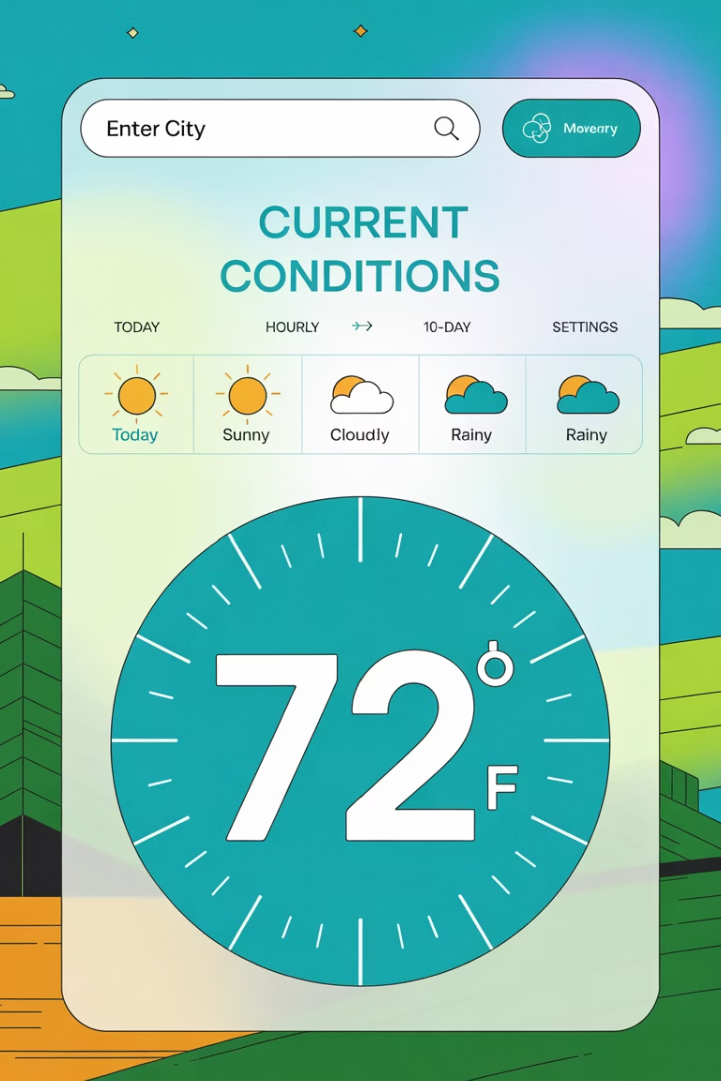
Weather Forecast Web Application
Built using Python + Flask + OpenWeather API
A lightweight, customizable solution for accessing real-time weather data using Python and Flask.
By Dhruv Aggarwal and Harshit Jethi

Slide 2

Problem Statement
Users need quick access to live weather updates but face challenges with existing solutions:
Many weather applications are resource-intensive
Limited customization options for developers
Complex interfaces with unnecessary features
Difficulty integrating weather data into other applications

Slide 3



Our Solution
Lightweight
Customizable
Real-Time
Minimal resource usage with fast load times
Easily modify the codebase to suit specific needs
Up-to-date weather information from OpenWeather API
A Flask-based web application that delivers current weather conditions for any city worldwide in a clean, accessible interface.

Slide 4
Technical Requirements
Python Environment
Key Dependencies
External Requirements
Python 3.x or higher
Flask (for routes & web server)
OpenWeatherMap API Key
Virtual environment recommended
HTML template (home.html)
Requests (for API calls)
Internet connection for API access
python-dotenv (load API key securely)
All packages can be installed via pip with a simple pip install -r requirements.txt

Slide 5

System Architecture
User enters city name in the web form
Flask processes the form submission
Application sends request to OpenWeatherMap API
API returns JSON data with weather information
Flask parses the JSON and extracts relevant data
Application renders home.html with the weather details

Slide 6
Core Features
City Search
Error Handling
Simple form for searching any global location
Graceful handling of invalid city names or API issues
Complete Conditions
Responsive Design
Temperature (°C & °F), feels like, humidity, pressure, wind speed
Works on both desktop and mobile browsers
Visual Indicators
Fast Performance
Weather condition with corresponding icon
Lightweight design ensures quick loading times

Slide 7
Code Structure
Route Handling
API Interaction
@app.route('/')def home(): return render_template('home.html')@app.route('/predict_weather', methods=['POST'])def predict_weather(): city = request.form.get('city') weather_data = fetch_weather_data(city) return render_template('home.html', data=weather_data)
def fetch_weather_data(city): api_key = os.getenv('OPENWEATHER_API_KEY') url = f"https://api.openweathermap.org/data/2.5/weather?q={city}&appid={api_key}" response = requests.get(url) if response.status_code == 200: return parse_weather_data(response.json()) return {'error': 'City not found'}
The application follows a clean, modular design that separates concerns and makes the code easy to maintain.

Slide 8
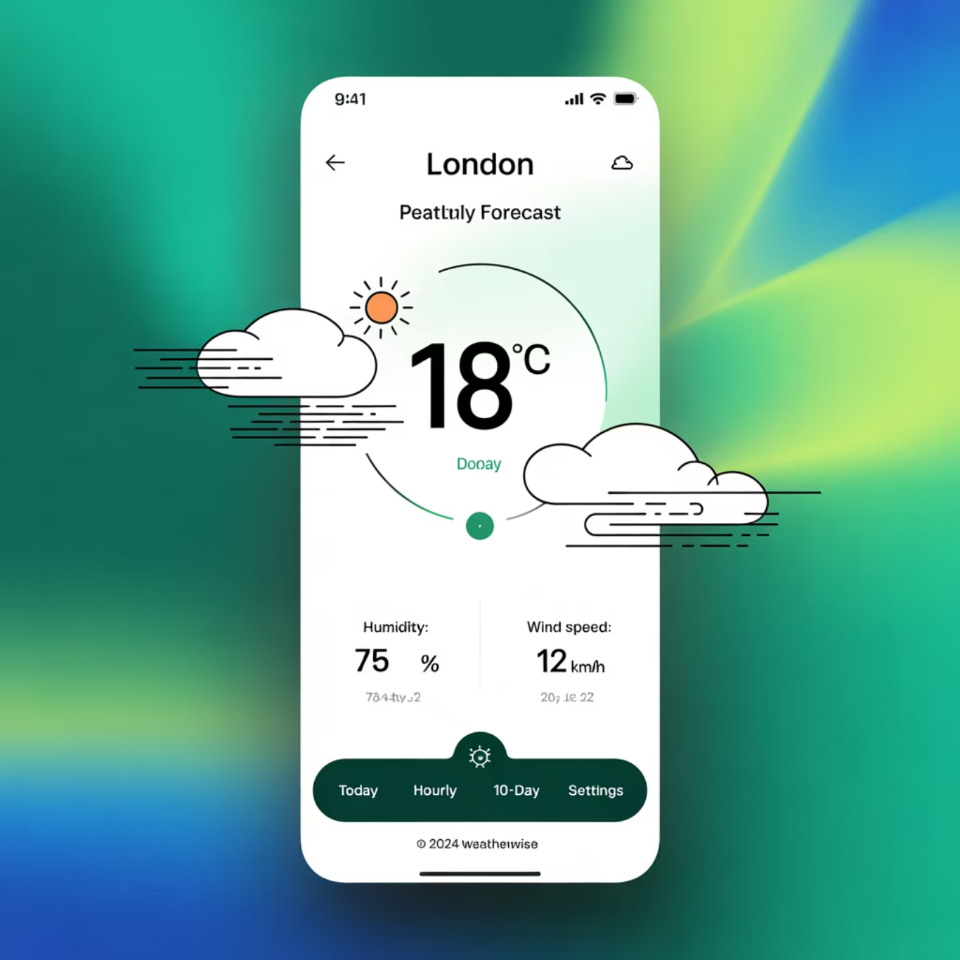
Example Output
User Input: "London"
1
Temperature
18°C / 64°F
Feels like: 17°C / 62.6°F
2
Conditions
Clear Sky 🌤
Humidity: 55%
Pressure: 1012 hPa
3
Wind
Speed: 4.1 m/s
Direction: NE

Slide 9










Future Enhancements
Data Visualization
Extended Forecasts
Interactive graphs and charts showing weather patterns
Hourly and weekly predictions with trend analysis
Geolocation
Automatic detection of user's current location
Localization
Support for multiple languages and regional preferences
Progressive Web App
Mobile-optimized version with offline capabilities
These enhancements will transform the application from a simple utility to a comprehensive weather platform.

Slide 10

Get Started Today
Quick Setup
# Clone the repositorygit clone https://github.com/yourusername/weather-app# Install dependenciespip install -r requirements.txt# Set up environment variablesecho "OPENWEATHER_API_KEY=your_api_key" > .env# Run the applicationflask run
Visit http://localhost:5000 in your browser to use the application
Contribute to the project on GitHub or customize it for your specific needs!

